Slide 1
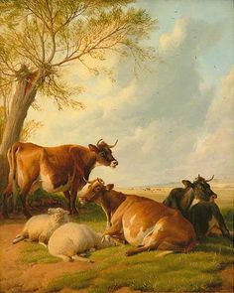
The Breeder’s Art
2016 ADCA AGM
Salina, KS
Jeff M. Chambers

Slide 2
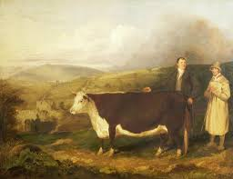
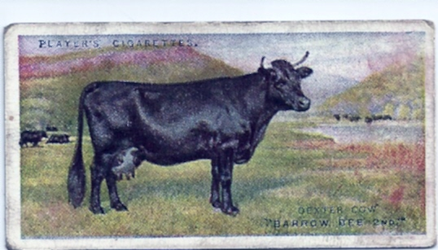
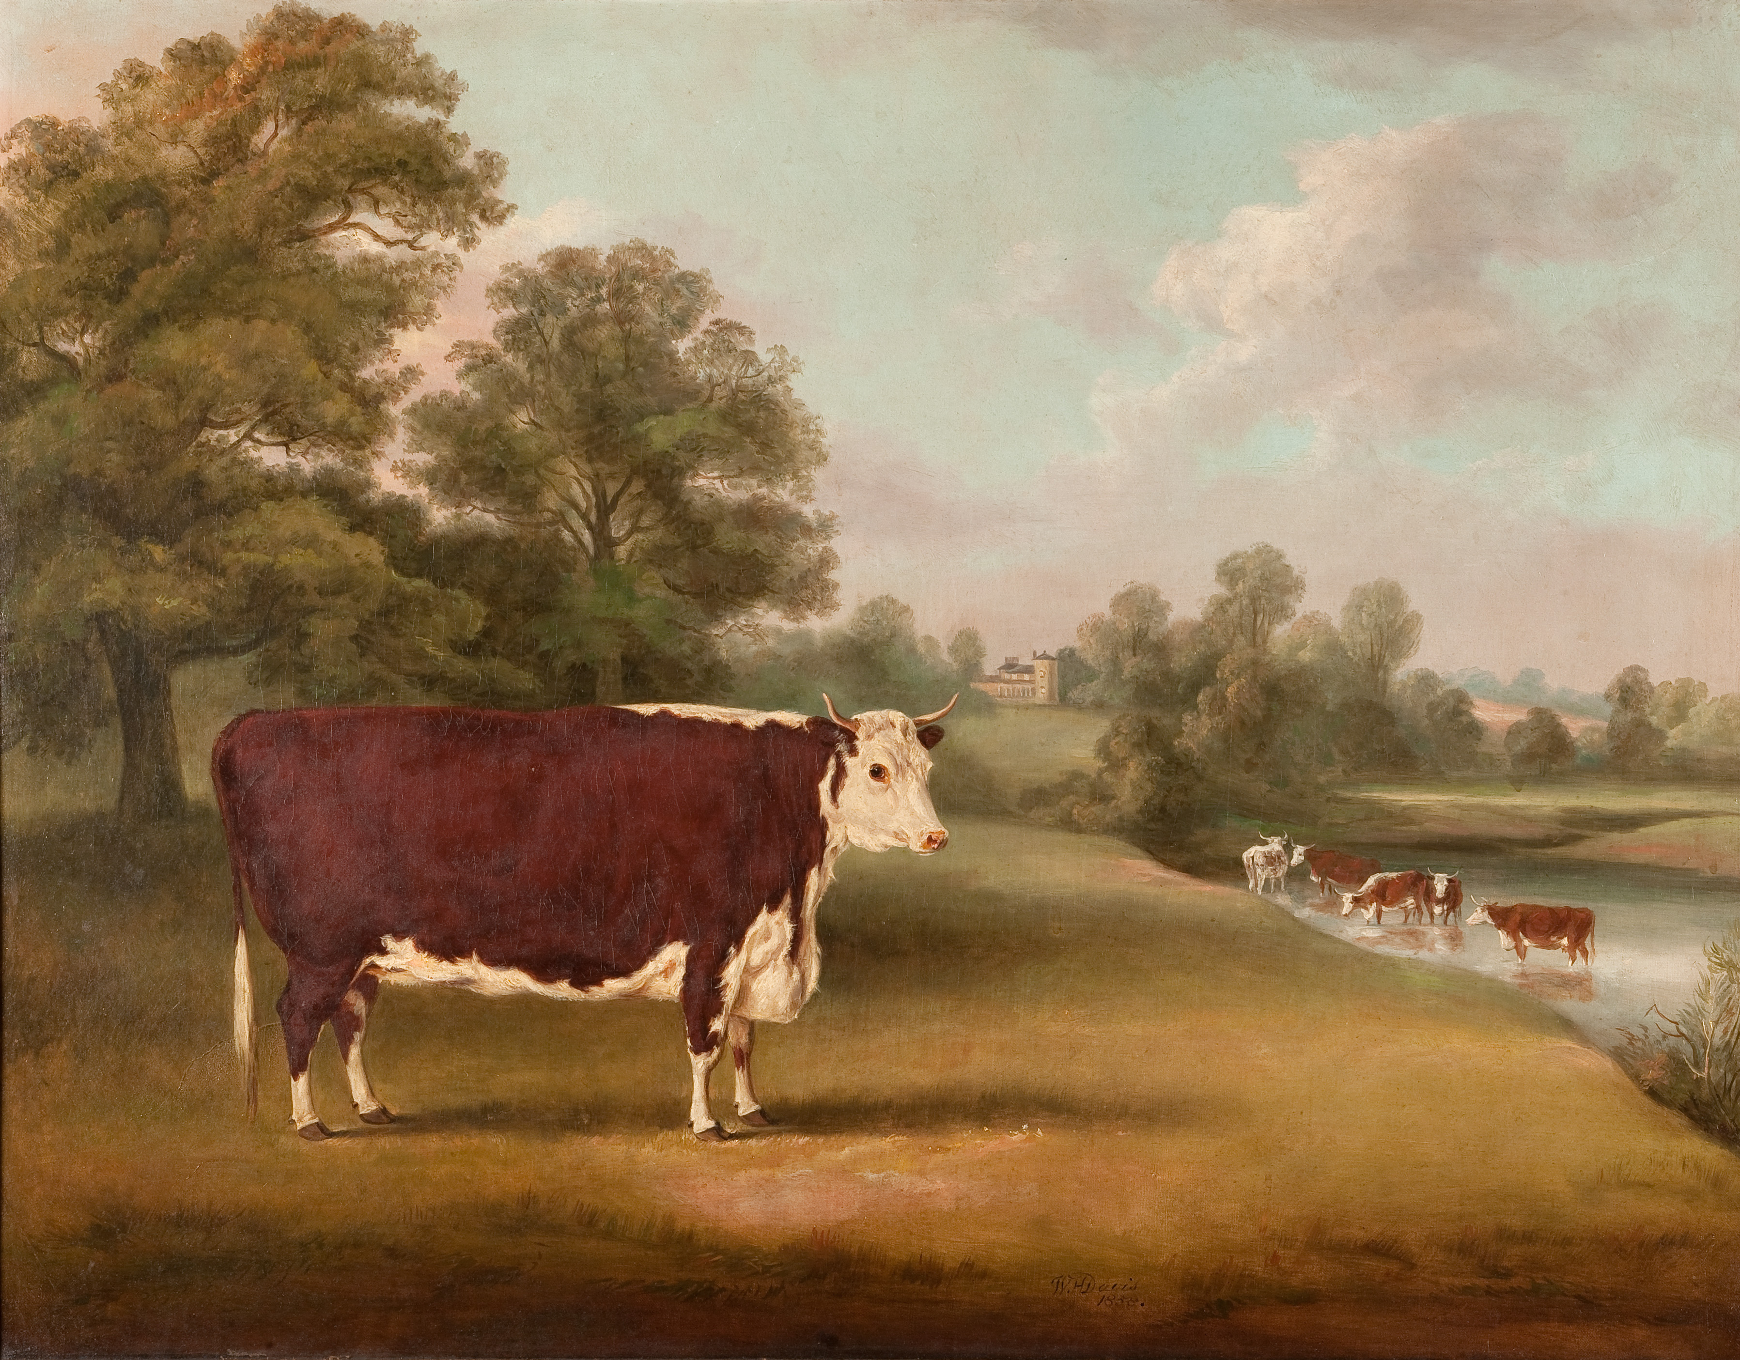
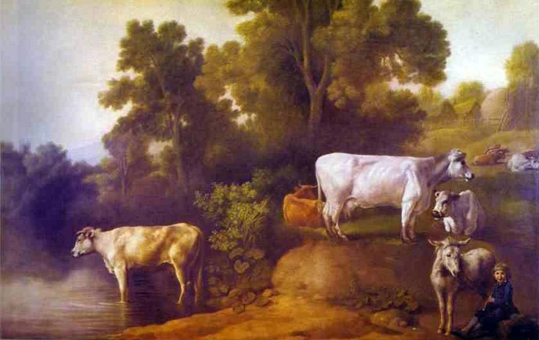

Slide 3
A discussion not a lecture
Breeding Perspectives
Breeding Goals
Breeder’s Tools
Successful purebred livestock breeding
is science and an art.

Slide 4
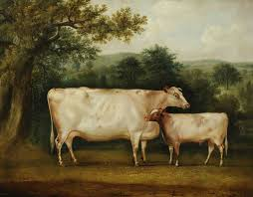
Breeding Perspectives
Conservative
Breeding for maintenance of an existing type or what has been achieved in the past
Little to no emphasis on improving upon the original stock.
Constructive
Breeding for improvement in stock
Combining genetics to fix the desired combination
Creative
Breeding to achieve something different from existing types
Combining genetics for different qualities
Adapted from Cochrane, E.R.

Slide 5
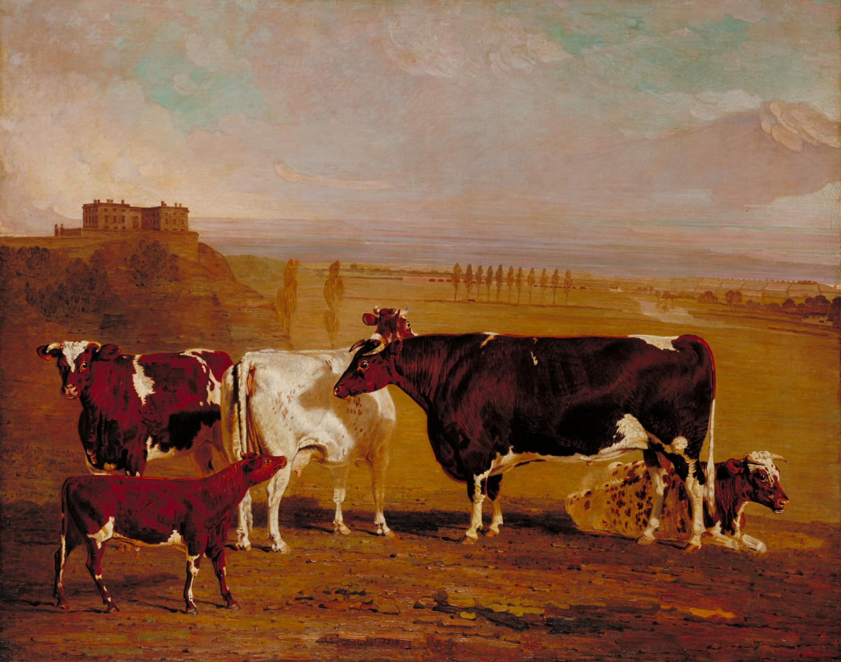
A Perspective on Breeding Perspectives
“Breeds that are removed from their production environments and kept only as interesting relics by dedicated hobbyists lose much of their contribution to the human endeavor and lose much of their relevance. They indeed lose much of their genetic makeup due to the change in selection pressure. “
Sponenberg and Bixby, 2007 Managing Breeds for A Secure Future: Strategies for Breeds and Breed Associations,

Slide 6
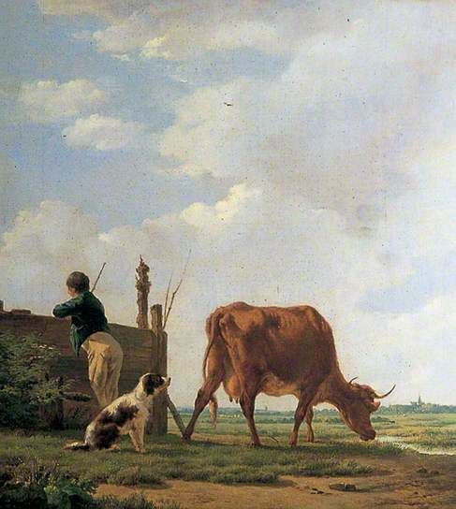
Breeder’s Tools
Selection is the breeder's tool box.
Within our tool box of selection we have available:
Phenotypic selection
Genetic Selection
Production selection
Inbreeding
Outbreeding
Managing health and environment

Slide 7
Inbreeding
“Those who are terrified of the results of inbreeding would do well to consider those of outbreeding, which although usually not obvious in the first generations, lead to chaos in subsequent one.”
“With inbreeding there is the danger of faulty phenotype; with outbreeding, of poor genotype.”
E . R. Cocharan “The Milch Cow in England”

Slide 8
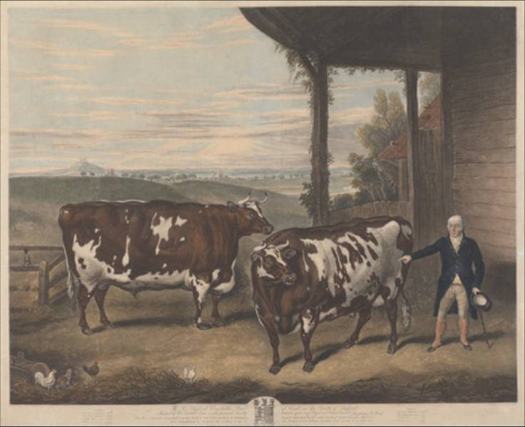
Successful Livestock Breeder Traits and Abilities
Passion
Vision / Imagination
Patience
Love of animals
Integrity
Capital
Critical self-examination
Intestinal fortitude
Notes:
Integrity is based upon the inherent desire to do right as between man and man. More than just honesty.

Slide 9
Why do we do what we do?
Why do we expend the time, financial resources, emotional and psychic capital on registered livestock?
What are the intangibles we derive from our shared avocation of cattle breeding and dexters specifically?
What are some goals we have established for our herds moving forward?

Slide 10
A Few Recommended Breeder Learning Resources
Cameron, N.D. 1997. Selection Indices and Prediction of Genet Merit in Animal Breeding
Cochran, E.R. (1945). The Milch Cow in England *
Falconer, D.S., and T.F.W. Mackay. 1996. Introduction to Quantitative Genetics
Hinman, C. (1953). Dual Purpose Cattle *
Lush, J.L. 1945. Animal Breeding Plans
Rice, V., Warwick E. (1953). Breeding Better Livestock
Sponenberg, D. & Bixby, D. 2007. Managing Breeds for A Secure Future: Strategies for Breeds and Breed Associations

